Slide 1


BUSINESS
项目汇报
学生学业预测
汇报人：许文瑞

Slide 2
01
02
03
04
CONTENTS
项目背景
开发历程
成果展示
项目总结

Slide 3
01
项目背景

Slide 4

01
项目背景
项目需求
对学生表现的预测成为大多数教育机构和学院的迫切需求
预测学生的表现，以吸引不同的学生参与研究和创新项目
对于教育学家和教育心理学工作者来说可以用来提供一些预测数据和实际数据作比较用作研究
通过选择预测结果不好的学生，对这些学生进行辅导
Notes:
然后说一下项目目标（根据学生的一些表现来预测学生学业水平）

Slide 5
02
开发历程

Slide 6
02
开发历程
模型迭代过程
XGBoost回归器
剔除成绩为0的样本使用XGBoost进行预测，并用均方根误差进行评价
贝叶斯分类算法(四分类)
将成绩分为四个等级并分别使用GaussianNB和Multinomia1NB分类器进行预测
CatBoost
由现有维度生产新维度，使用CatBoost进行预测，并用均方根误差进行评价
贝叶斯分类算法(二分类)
将成绩分为两个等级并分别使用GaussianNB和Multinomia1NB分类器进行预测

Slide 7
c
02
开发历程
贝叶斯算法
2
 | G | M
R2值 | 0.762 | 0.713
auc | 0.797 | 0.766
1
 | G | M
R²值 | 0.303 | 0.540
auc | 0.512 | 0.523
将成绩分为四个等级并分别使用GaussianNB和Multinomia1NB分类器进行预测
贝叶斯算法

Slide 8


02
开发历程
模型迭代过程
CatBoost回归器
R²值: 0.3123073836119675
RSME: 2.321501045083196
XGBoost回归器
R²值: 0.3084157932510938
RSME: 2.328060360826329

Slide 9
03
成果
展示
The user can demonstrate on a projector or computer, or print the presentation and make it into a in a wider field

Slide 10
03
成果展示
The user can demonstrate on a projector or computer
标题文字添加
The user can demonstrate on a projector or computer, or print the presentation and make it into a film to be used in a wider field. Using PowerPoint,
标题文字添加
The user can demonstrate on a projector or computer, or print the presentation and make it into a film to be used in a wider field. Using PowerPoint,
标题文字添加
标题文字添加
The user can demonstrate on a projector or computer, or print the presentation and make it into a film to be used in a wider field. Using PowerPoint,

Slide 11
03
发展规划
The user can demonstrate on a projector or computer
标题文字添加
The user can demonstrate on a projector or computer, or presentation and make it film to be used in a wider field
关 键词
标题文字添加
关键词
The user can demonstrate on a projector or computer, or presentation and make it film to be used in a wider field
标题文字添加
关键词
The user can demonstrate on a projector or computer, or presentation and make it film to be used in a wider field
标题文字添加
关键词
The user can demonstrate on a projector or computer, or presentation and make it film to be used in a wider field

Slide 12
03
发展规划
The user can demonstrate on a projector or computer
2018
标题文字添加
2017
The user can demonstrate on a projector or computer, or print the presentation and make it into a film to be used
标题文字添加
2016
The user can demonstrate on a projector or computer, or print the presentation and make it into a film to be used
标题文字添加
2015
The user can demonstrate on a projector or computer, or print the presentation and make it into a film to be used
标题文字添加
The user can demonstrate on a projector or computer, or print the presentation and make it into a film to be used

Slide 13
04
项目
总结
The user can demonstrate on a projector or computer, or print the presentation and make it into a in a wider field

Slide 14

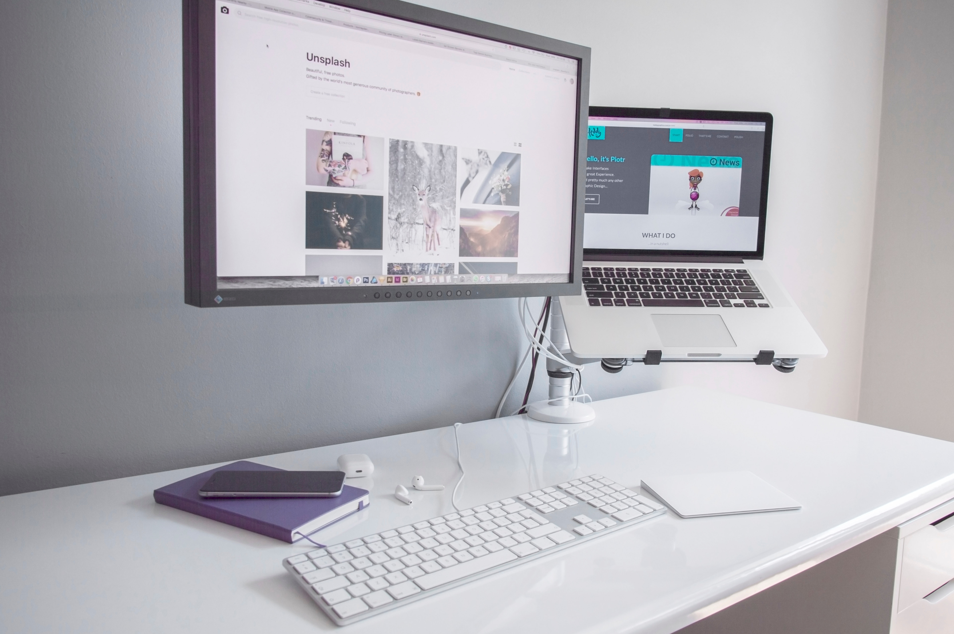

04
资本融资
The user can demonstrate on a projector or computer
标题文字添加
标题文字添加
The user can demonstrate on a projector or computer, or print the presentation and make it into a film to be used in a wider field
The user can demonstrate on a projector or computer, or print the presentation and make it into a film to be used in a wider field
01
03
02
标题文字添加
The user can demonstrate on a projector or computer, or print the presentation and make it into a film to be used in a wider field

Slide 15



04
资本融资
The user can demonstrate on a projector or computer
标题文字添加
标题文字添加
标题文字添加
The user can demonstrate on a projector or computer, or print the presentation and make it into a film to be used in a wider field. Using PowerPoint,
The user can demonstrate on a projector or computer, or print the presentation and make it into a film to be used in a wider field. Using PowerPoint,
The user can demonstrate on a projector or computer, or print the presentation and make it into a film to be used in a wider field. Using PowerPoint,

Slide 16
04
资本融资
The user can demonstrate on a projector or computer
标题文字添加
标题文字添加
标题文字添加
标题文字添加
The user can demonstrate on a projector or computer, or presentation and make it film to be used in a wider field
The user can demonstrate on a projector or computer, or presentation and make it film to be used in a wider field
The user can demonstrate on a projector or computer, or presentation and make it film to be used in a wider field
The user can demonstrate on a projector or computer, or presentation and make it film to be used in a wider field

Slide 17
BUSINESS
谢谢观看
汇报人：许文瑞

